Slide 1
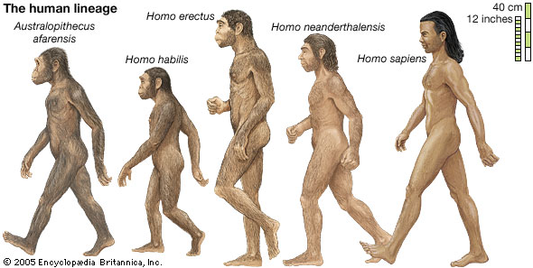
Hominin Evolution
Chapter 12 and Chapter 13 Human Perspectives
Intro
Adaptations for Erect Posture

Slide 2
Date: | Human Biology Year 12 ATAR
Do Now Get out equipment – new topic today! Lesson Agenda 1: Do Now 2: Hominin Evolution Intro 3: Hominin Evolution – Adaptations for Bipedalism 4: Lesson summary and windup Suggested Study Read through today’s notes and textbook section Complete review worksheet, then mark and correct using the answer key on Connect (compulsory). NEXT LESSON Do Now past exam question Go through recent test Hominin Evolution – Prognathism and Dentittion | Learning Aims Define bipedalism and describe evidence that recent human ancestors were bipedal. Discuss environmental changes that favoured bipedalism Explain why bipedalism was an advantage in this environment List anatomical adaptations for bipedalism/erect posture Describe the following adaptations and explain how they assist with bipedalism: Foramen magnum position Curvature of the spinal column Reduced Prognathism Pelvic shape Carrying angle of the Femur Knee Adaptations Platform Foot Centre of Gravity Stance and Muscle Tone Striding Gait
 | Key Vocabulary Bipedalism Quadrupedalism Foramen magnum Prognathism

Slide 3
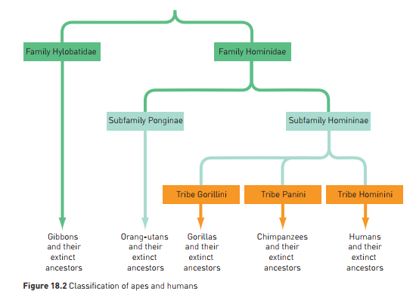

Slide 4
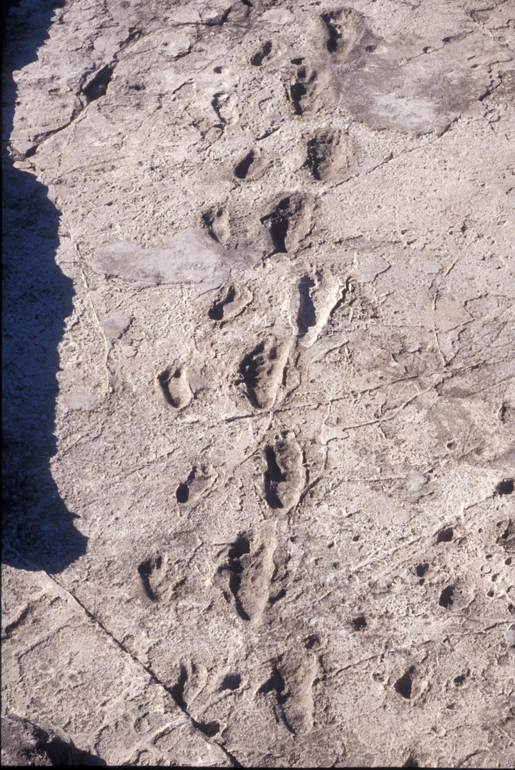
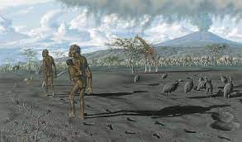
Bipedalism – walking on two legs
Humans have unique locomotion compared to other primate species.
Other primates (eg monkeys, gorillas, chimps) are quadrupedal.
Humans have evolved to be bipedal.
Some extinct human ancestors must have been bipedal and this must have been an advantage in the environment.
First evidence of ancestral bipedalism – The Laetoli Footprints – 3 million years old
Made by Australopithecus – footprints fossilised in volcanic ash
Only 2 feet in prints
Feet showed adaptations for bipedalism (more on this later)
Note – this does not mean that Australopithecus was the first bipedal human ancestor – just the first we have excellent evidence for. Earlier ancestors would have shown a slow sequence of changes towards bipedalism.
Learning Aim: Define bipedalism and describe evidence that recent human ancestors were bipedal.

Slide 5
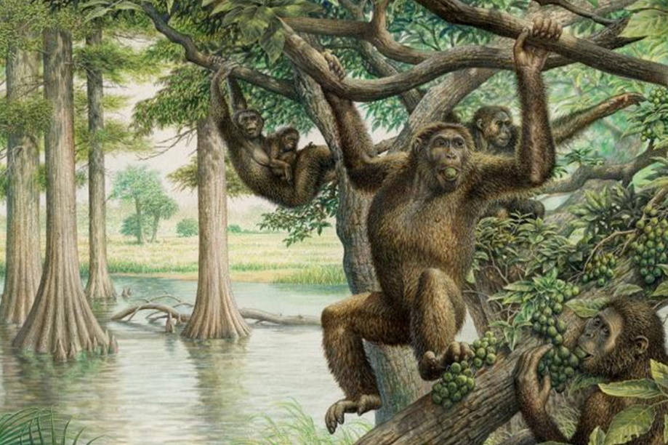
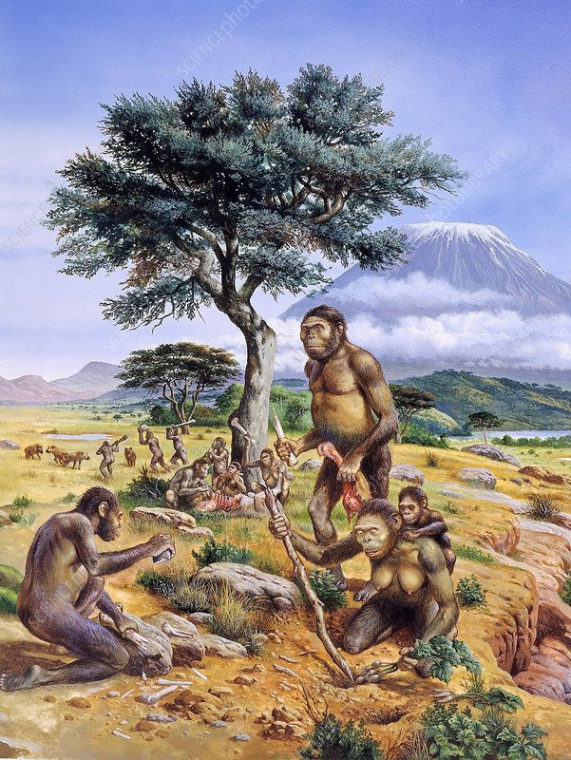
Selection Pressures and Evolution of Bipedalism
Evolution by natural selection means environment must have favoured bipedalism for human ancestors:
Hominins that evolved into human ancestors originally lived in woodland environment
Ape-like
Arms and hands suited to arboreal lifestyle
May have used some bipedal movement to get through forest clearings – like modern Orangutans.
Environmental change in Africa 5-6 million years ago
Temperatures fell and rainfall decreased
Forest areas diminished
Open grassland increased
Slow evolutionary changes towards bipedalism would have been favoured.
Learning Aim: Discuss environmental changes that favoured bipedalism.

Slide 6
Selection Pressures and Evolution of Bipedalism
Increase in open grassland caused bipedalism and other traits to be advantageous
Bipedalism is a more energy efficient mode of locomotion on the ground
Increased range of vision to detect prey and predators
Increased height/size deterred predators
Hands free for carrying food, using tools etc
Higher reach to pick fruit or collect honey
Less exposure to sunlight, greater surface areas for breezes – better temperature regulation in open grassland.
Food supply limited as forests replaced by grasslands
Caused selection pressure and made bipedalism a big selective advantage
Learning Aim: Explain why bipedalism was an advantage in an open grassland environment.

Slide 7
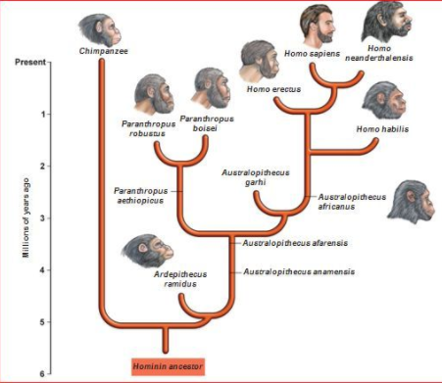
Bipedal Human Ancestors
Bipedal human ancestors
Extinct ancestors of present-day humans
Apes alive today and humans share a common ancestor. Human lineages and ape lineages diverged from that common ancestor.
Hominids of interest to this course:
Australopithecus
Homo habilis
Homo erectus
Homo neanderthalensis
Homo sapiens
Learning Aim: Review extinct bipedal human ancestors and when they existed.

Slide 8
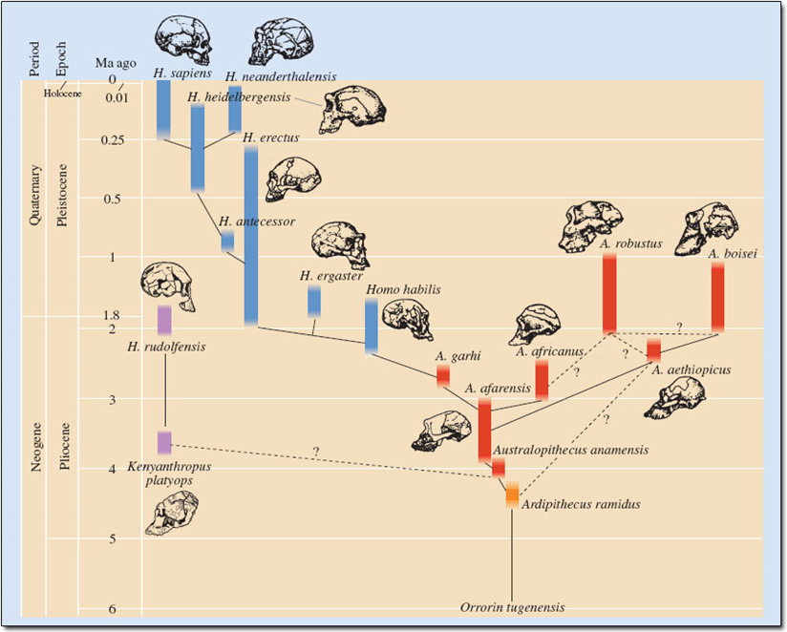

Slide 9
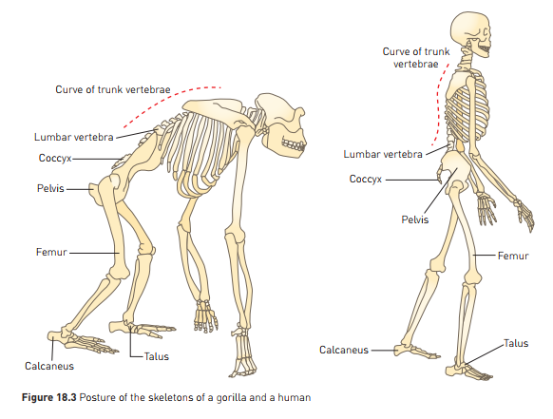
Adaptations for Bipedalism/Erect Posture
Skeleton and muscles of humans are adapted for erect posture to enable bipedal locomotion
Extinct bipedal human ancestors show a progression in these adaptations
Can see these adaptations by comparing humans with our close quadrupedal relative - the gorilla.
Adaptations for erect posture/bipedalism include:
Position of Foramen Magnum and Skull
Curve of spinal Column
Jaw (reduced prognathism)
Pelvis
Carrying angle
Knee
Foot
Centre of Gravity
Stance and muscle tone
Striding gait
Learning Aim: List anatomical adaptations for bipedalism/erect posture.

Slide 10
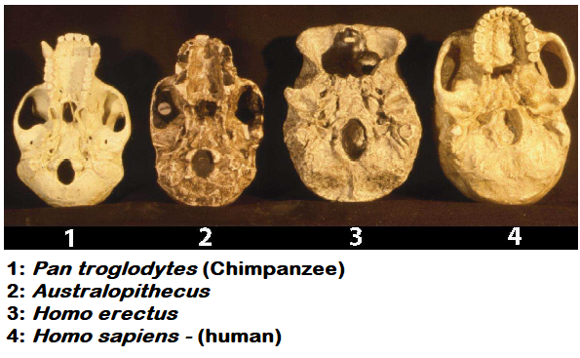
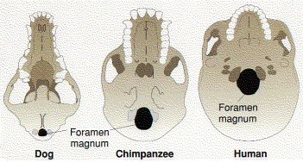
Adaptations for Bipedalism – position of Foramen Magnum
Foramen Magnum
Hole in base of skull where spinal cord joins brain
Quadrupeds: Foramen magnum is towards back of skull
In Bipeds the Foramen Magnum sits at the centre of the base of the skull
Skull sits atop spinal column – balances.
Position of skull reduces force and muscle needed to hold head up.
Can see evolutionary progression in extinct ancestors
Learning Aim: Describe how the foramen magnum is positioned for bipedalism and why this is an advantage.

Slide 11
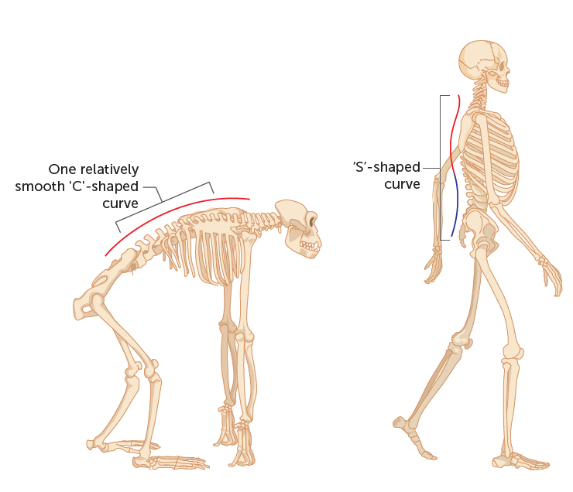
Adaptations for Bipedalism– Curvature of Spinal Column
Humans: double curvature – S shape
Contributes to upright stance
Lumbar spine: vertebrae wedge shaped – forward curve
Improves body balance while upright
Cervical curve brings centre of gravity of skull over spine.
Compare to quadruped apes – C shaped spine
Learning Aim: Describe how spinal curvature is adapted for bipedalism and why this is an advantage.

Slide 12
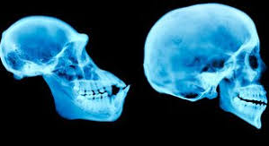
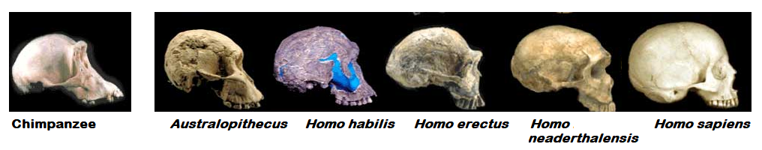
Adaptations for Bipedalism – reduced prognathism
Prognathism = protruding jaw
Apes are prognathic – jaw juts out.
Humans: jaw is much flatter to face
Allows skull to balance better on spinal cord – prevents front of skull from being heavier than back – less muscle needed to raise head.
Jaw size also significant for other reasons – more on this later
Learning Aim: Describe adaptations to the jaw for bipedalism and why this is an advantage.

Slide 13
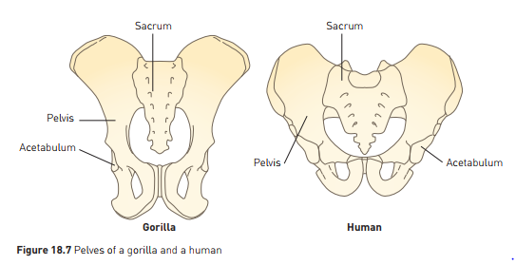
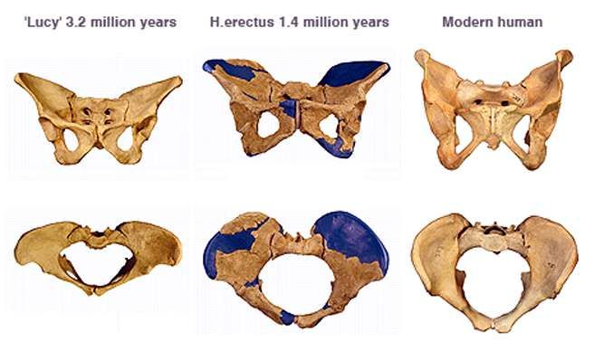
Adaptations for Bipedalism – The Pelvis
Humans: have a broader, flatter, shorter, bowl shaped pelvis than quadrupedal apes. This pelvis can be seen in bipedal human ancestors, trending more bowl shaped over time.
Broad, flat, short, bowl shaped pelvis:
Supports abdominal organs when standing up
Supports developing foetus in female
Female pelvis slightly broader than male – birth
Broad hip bones – attachment for large buttocks – move legs, keeps upper body erect
Learning Aim: Describe how the pelvis is adapted for bipedalism and why this is an advantage.

Slide 14
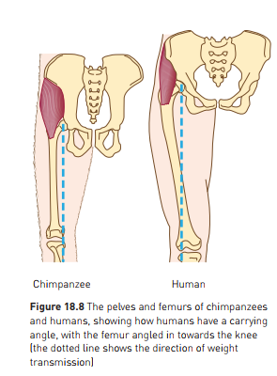
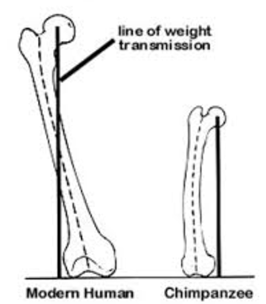
Adaptations for Bipedalism – Carrying Angle
The Carrying Angle
Refers to the positioning of bones and muscles in legs, to carry body weight.
In humans the carrying angle is adapted for bipedalism
hip joint directly under trunk and head
Large femoral head
Fits into well formed hip socket (acetabulum)
Hip sockets wide apart
Femurs converge (are closer together) towards knees
At angle to vertical
This is called the “carrying angle”
Ensures weight distribution stays close to central axis of body
Allows upright, stable, striding gait, rather than side to side rocking gait seen in apes
Weight transmission falls outside femur
Compare with bipedal chimps – see diagrams
Learning Aim: Describe how the carrying angle of the femur is adapted for bipedalism and why this is an advantage.

Slide 15
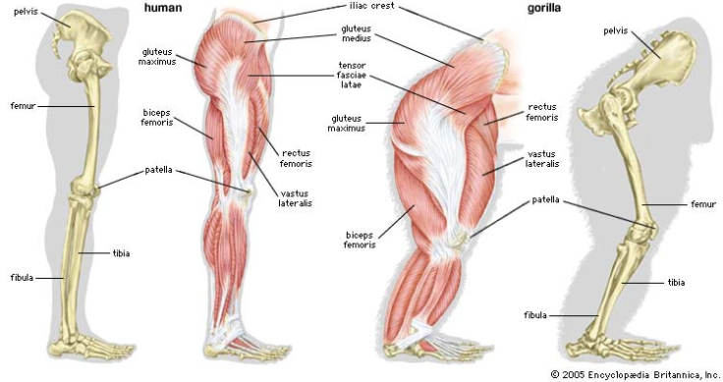
Adaptations for Bipedalism – Carrying Angle
Note that in humans, the hip joint is in line with the abdomen, chest and head, allowing for upright posture.

Slide 16
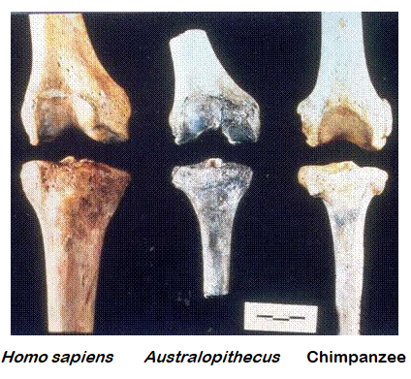
Adaptations for Bipedalism – the Knee
In bipedal humans and human ancestors:
Weight transmitted down outside of femur to knee
2 part hinge joint angled for weight transmission. Shaping of joint allows outer aspect to be stronger.
Centre of gravity falls just in front of knees
Force pushes to bend knee backwards, resisted by knee ligaments
Natural resistance of joint requires no energy to hold body in standing position
Compare to quadrupedal hominins (see picture)
Learning Aim: Describe how the knee is adapted for bipedalism and why this is an advantage.

Slide 17
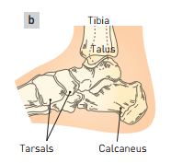
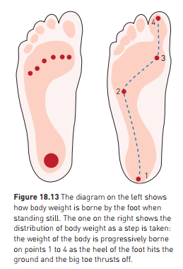
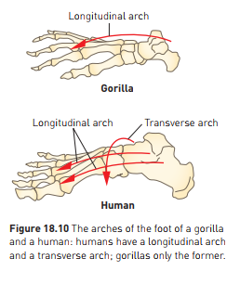
Adaptations for Bipedalism – the foot (and lower leg)
In bipedal hominins, from the knee joint, the weight is transmitted through the tibia to the ankle.
Tibia larger and stronger than fibula.
At ankle, body weight transmitted from tibia through ankle bone (talus) to other tarsal bones, to metatarsals and phalanges, via foot arch.
Bipedal foot distinctively adapted
“Platform foot”
Has lost flexibility and therefore prehensility
Large big toe, not opposable, aligned with other toes
Metatarsals form arches – longitudinal and transverse
Allows striding gait as foot “rolls” with movement.
Learning Aim: Describe how the foot is adapted for bipedalism and why this is an advantage.

Slide 18
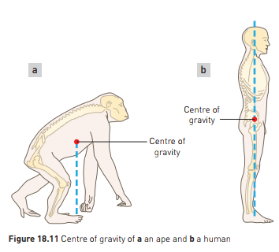
Adaptations for Bipedalism – Centre of Gravity
Low Centre of Gravity makes balancing easier.
Humans: legs longer than arms.
(1/2 of height vs 1/3 of height in chimps)
Long legs increase stride length
Lowers the centre of gravity to pelvis (chest in chimps)
Lower centre of gravity contributes to stability when standing/walking
Learning Aim: Describe how the centre of gravity is adapted for bipedalism and why this is an advantage.

Slide 19
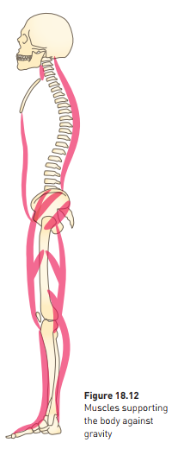
Adaptations for Bipedalism - Stance and Muscle Tone
Muscle Tone
Essential for maintaining an upright stance (erect posture).
Consistent and partial contraction of skeletal muscles.
Muscles required for balance in upright stance need greater muscle tone:
Spinal muscles
Hip, knee, ankle
Abdominals
Nervous system and sense organs work together to maintain muscle tone
Learning Aim: Describe how stance and muscle tone are adapted for bipedalism and why this is an advantage.

Slide 20
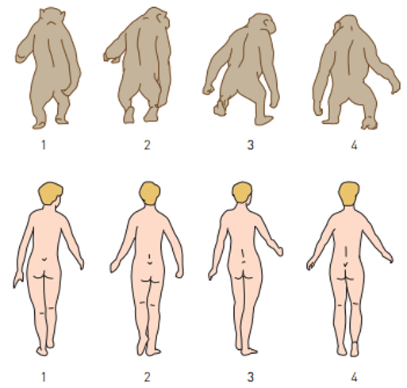
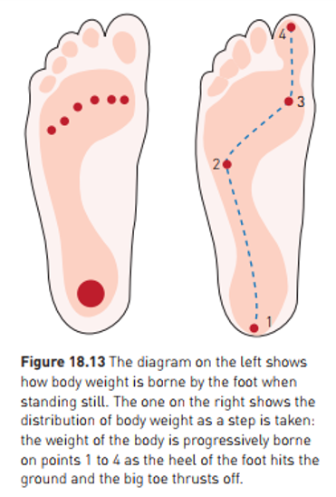
Adaptations for Bipedalism – Striding Gait
Walking upright with hip and knee fully straightened.
Only bipedal hominins (humans and extinct recent ancestors) have this form of locomotion.
Other hominids bend forward at hips, knees bent, swaying gait.
Arches of bipedal foot allow rolling movement, heel to big toe
Human big toe no longer prehensile or opposable: allows stability for weight-bearing in striding gait.
Trunk rotates around pelvis
Arms swing forwards
Shoulders at right angles to direction of movement
Arrangement of femurs allows weight distribution close to central axis
Learning Aim: Describe how gait is adapted for bipedalism and why this is an advantage.

